Slide 1
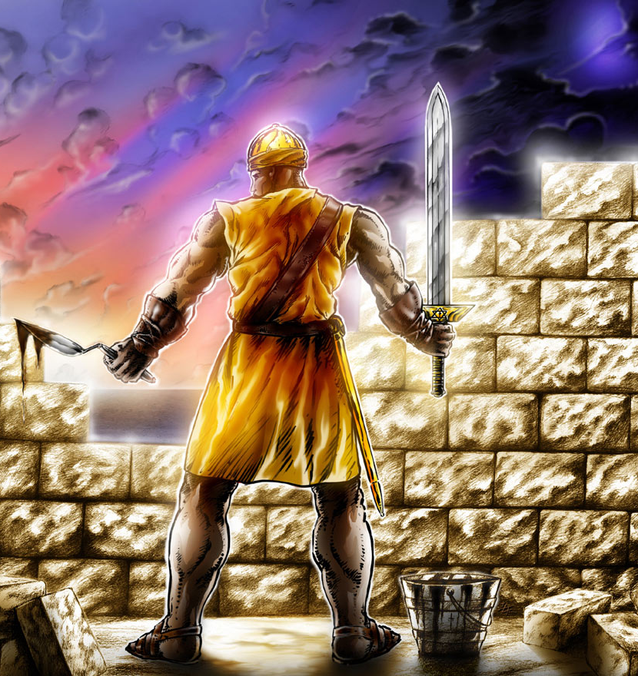
Nehemiah 4
Keep hold of your sword!

Slide 2
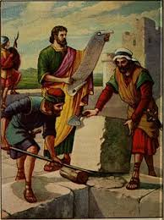
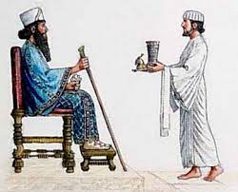
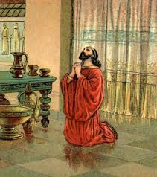
Nehemiah – who is he?
Cup-bearer to the king
Prayed to God in repentance on behalf of the nation
Led the rebuilding of the wall of Jerusalem

Slide 3
Context
The Jews were exiled to Babylon in 586BC
Nehemiah led 3rd group of exiles returning to Jerusalem in 445BC
Tasked with rebuilding the wall of Jerusalem by God

Slide 4
Chapter 4 overview
Sanballat and Tobiah mock the attempts to rebuild the wall
Nehemiah prays against them – wall is built to half height
Sanballat and Tobiah are angry! They plan to attack the workers
The plot is uncovered
Nehemiah rallies the workers to fight!
Sanballat and Tobiah call off the attack after they realise their plot has been uncovered
Nehemiah sets half to defend, half to work
The workers continue, sword in one hand and tools in the other

Slide 5


Slide 6
God has given us work to do
Chapter 1:1-3 ‘The words of Nehemiah the son of Hacaliah. Now it happened in the month of Chislev in the twentieth year that I was in Susa the capital, that Hanani, one of my brothers, came with certain men from Judah. And I asked them concerning the Jews who escaped, who had survived the exile, and concerning Jerusalem. And they said to me, “The remnant there in the province who had survived the exile is in great trouble and shame. The wall of Jerusalem is broken down, and its gates are destroyed by fire.”’

Slide 7
God has given us work to do
Chapter 2:17-18 ‘Then I said to them, “You see the trouble we are in, how Jerusalem lies in ruins with its gates burned. Come, let us build the wall of Jerusalem that we may no longer suffer derision.” And I told them of the hand of my God that had been upon me for good, and also of the words that the king had spoken to me. And they said, “Let us rise up and build.” So, they strengthened their hands for the good work.”

Slide 8
God has given us work to do
Chapter 4:6 “So we built the wall. And all the wall was joined together to half its height, for the people had a mind to work.”

Slide 9
God has given us work to do
Matthew 28:19-20 ‘And Jesus came and said to them, “All authority in heaven and on earth has been given to me. Go therefore and make disciples of all nations, baptising them in the name of the Father and of the Son and of the Holy Spirit, teaching them all that I have commanded you. And behold, I am with you always, to the end of the age.”’

Slide 10
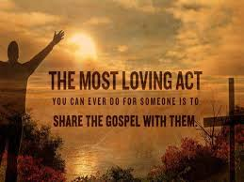
God has given us work to do

Slide 11
There will be opposition, but god is our defence
Verses 1-5 ‘Now when Sanballat heard that we were building the wall, he was angry and greatly enraged, and he jeered at the Jews. And he said in the presence of his brothers and of the army of Samaria, “What are these feeble Jews doing? Will they restore it for themselves? Will they sacrifice? Will they finish in a day? Will they revive the stones out of heaps of rubbish, and burned ones at that?” Tobiah the Ammonite was beside him, and he said, “Yes, what they are building – if a fox goes up on it he will break down their stone wall!” Hear, O God, for we are despised. Turn back their taunt on their own heads and give them up to be plundered in a land where they are captives. Do not cover their guilt, and let not their sin be blotted out from your sight, for they have provoked you to anger in the presence of the builders.’

Slide 12
There will be opposition, but god is our defence
Verses 7-14 ‘But when Sanballat and Tobiah and the Arabs and the Ammonites and the Ashododites heard that the repairing the walls of Jerusalem was going forward and that the breaches were beginning to be closed, they were very angry. And they all plotted together to come and fight against Jerusalem and to cause confusion in it. And we prayed to our God and set a guard as a protection against them day and night. In Judah it was said, “The strength of those who bear the burdens is failing. There is too much rubble. By ourselves we will not be able to rebuild the wall.”

Slide 13
There will be opposition, but god is our defence
And our enemies said, “They will not know or see till we come among them and kill them and stop the work.” At that time the Jews who lived near them came from all directions and said to us ten times, “You must return to us.” So in the lowest parts of the space behind the wall, in open places, I stationed the people by their clans, with their swords, their spears, and their bows. And I looked and arose and said to the nobles and to the officials, and to the rest of the people, “Do not be afraid of them. Remember the Lord, who is great and awesome, and fight for your brothers, your sons, your daughters, your wives, and your homes.”

Slide 14
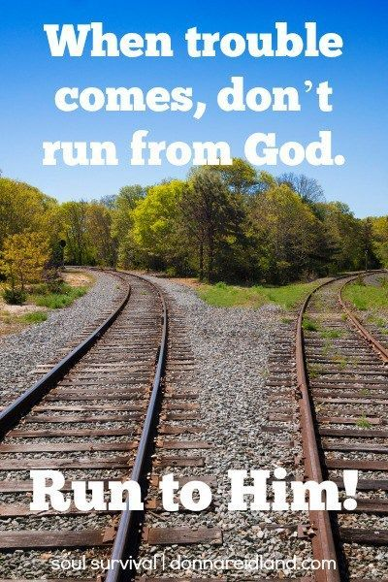
There will be opposition, but god is our defence

Slide 15
There will be opposition, but god is our defence
Psalm 33:20 ‘Our soul waits for the Lord; he is our help and our shield.’
Joshua 1:9 ‘“Have I not commanded you? Be strong and courageous. Do not be frightened, and do not be dismayed, for the Lord your God is with you wherever you go.”’

Slide 16
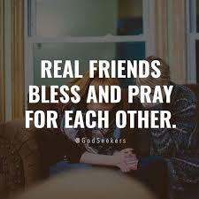
There will be opposition, but god is our defence

Slide 17
There will be opposition, but god is our defence
Genesis 3:1 ‘Now the serpent was more crafty than any other beast of the field that the Lord God had made. He said to the woman, “Did God actually say, ‘You shall not eat of any tree in the garden’?”’

Slide 18
Carry your sword and stand firm!
Verses 16-23 ‘From that day on, half of my servants worked on construction, and half held the spears, shields, bows, and coats of mail. And the leaders stood behind the whole house of Judah, who were building on the wall. Those who carried burdens were loaded in such a way that each laboured on the work with one hand and held his weapon with the other. And each of the builders had his sword strapped at his side while he built. The man who sounded the trumpet was beside me. And I said to the nobles and to the officials and to the rest of the people, “The work is great and widely spread, and we are separated on the wall, far from one another.

Slide 19
Carry your sword and stand firm!
In the place where you hear the sound of the trumpet, rally to us there. Our God will fight for us.” So we laboured at the work, and half of them held the spears from the break of dawn until the stars came out. I also said at that time, “Let every man and his servant pass the night within Jerusalem, that they may be a guard for us by night and may labour by day.” So neither I nor my brothers nor my servants nor the men of the guard who followed me, none of us took off our clothes; each kept his weapon at his right hand.’

Slide 20
Carry your sword and stand firm!
Ephesians 6:10-18 ‘Finally, be strong in the Lord and in the strength of his might. Put on the whole armour of God, that you might be able to stand against the schemes of the devil. For we do not wrestle against flesh and blood, but against the rulers, against the authorities, against the cosmic powers over this present darkness, against the spiritual forces of evil in the heavenly places. Therefore take up the whole armour of God, that you might be able to withstand in the evil day, and having done all, to stand firm.

Slide 21
Carry your sword and stand firm!
Stand therefore, having fastened on the belt of truth, and having put on the breastplate of righteousness, and, as shoes for your feet, having put on the readiness given by the gospel of peace. In all circumstances take up the shield of faith, with which you can extinguish all the flaming darts of the evil one; and take the helmet of salvation, and the sword of the Spirit, which is the word of God, praying at all times in the Spirit, with all prayer and supplication. To that end keep alert with all perseverance, making supplication for all the saints…’

Slide 22
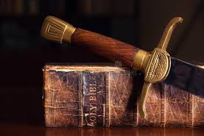
Carry your sword and stand firm!

Slide 23
Carry your sword and stand firm!
Jeremiah 17:7-9 ‘“Blessed is the man who trusts in the Lord, whose trust is in the Lord. He is like a tree planted by water, that sends out its roots by the stream, and does not fear when heat comes, for its leaves remain green, and is not anxious in the year of the drought, for it does not cease to bear fruit.” The heart is deceitful above all things, and desperately sick; who can understand it?’

Slide 24
Finally…
There is work to be done – preach the gospel
There will always be opposition from the enemy, but God is our defender
Carry your sword and stand firm!
1 Corinthians 16:13 ‘Be watchful, stand firm in the faith, act like men, be strong.’

